Slide 1
Quantum Computing
Agriculture
Instructor: Professor Ahmed Banafa
CS589 - Special Topics: Quantum Computing

Slide 2
Team Members
Akshaykumar Patel (19938)
Prince Paneliya (19885)
Abhishek Sukhadiya (20076)

Slide 3
Outline
Quantum Computing Fundamentals
Quantum Computing in Agriculture: Overview
Crop Optimization
Fertilizer Development
Pest Control
Supply Chain Management
Case Studies
Challenges and Limitations
Future Outlook
Ethical Considerations
Conclusion

Slide 4
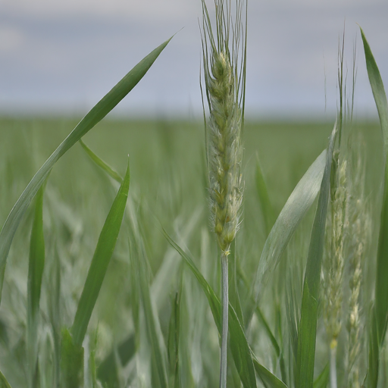
Quantum Computing: A New Era for Agriculture
The growing global population is increasing the demand for food, putting a strain on resources.
Quantum computing utilizes quantum mechanics to solve complex problems traditional approach cannot.
Quantum computing can - optimize crop yields - develop efficient fertilizers - enhance pest control.
By revolutionizing agriculture, quantum computing addresses - food security - sustainability challenges.

Slide 5
Introduction - Integration into QC
Aim: increase agricultural productivity with minimizing inputs and pollutants
Traditional agriculture challenges
Resource allocation
Precise monitoring of environmental conditions
Intelligent decision-making for optimal crop production
Quantum-enhanced machine learning models for
agricultural productivity
crop disease prediction
can be assessed for climate change impact (via modeling and simulation tools)

Slide 6
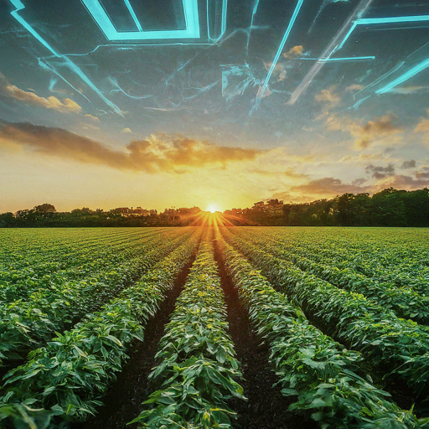
Understanding Quantum Computing Fundamentals
Quantum computing harnesses the power of quantum mechanics to perform complex calculations.
Qubits can exist in superposition, representing 0 and 1 simultaneously (unlike classical bits)
Entanglement allows qubits to become interconnected, influencing each other's states(correlation)
Quantum computers excel at solving problems that are intractable for classical computers.
This speed and efficiency open doors to advancements in various fields, including agriculture.

Slide 7

Quantum Computing in Agriculture
Crop Optimization: Quantum algorithms can analyze vast datasets to identify optimal crop varieties and growing conditions.
Fertilizer Development: Quantum simulations can design fertilizers that are more efficient and environmentally friendly.
Supply Chain Management: Quantum optimization algorithms can improve the efficiency and sustainability of agricultural supply chains.
Pest Control: Quantum computing can help develop targeted pest control strategies, reducing the need for harmful chemicals.

Slide 8
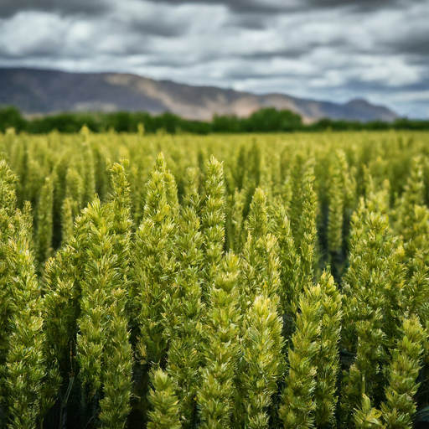
Crop Optimization with Quantum Computing
Quantum algorithms analyze vast datasets to identify optimal crop varieties.
Quantum simulations model complex biological processes like photosynthesis.
This leads to crops that are more resilient to disease, drought, and pests.
Crops can be optimized for specific growing conditions and environments.
Increased yields and reduced resource consumption are possible benefits.

Slide 9

Fertilizer Development with Quantum Computing
Quantum algorithms can simulate molecular interactions at the atomic level.
This allows for the design of fertilizers that are precisely tailored to specific crops and soil conditions.
Quantum computing can optimize fertilizer formulations for maximum nutrient uptake efficiency.
Potential benefits include reduced environmental impact, increased crop yields, and cost savings.

Slide 10
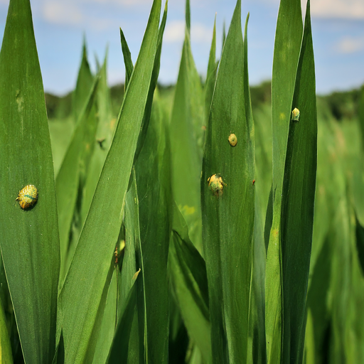
Quantum Computing
for Pest Control
Quantum simulations model pest life cycles, behavior, and interactions with crops.
Predict and monitor pest outbreaks, identifying high-risk areas.
Develop targeted pesticides and biocontrols, minimizing environmental impact.
Optimize timing and application of pest control measures for maximum effectiveness.
Quantum computing identifies vulnerabilities in pest biology for novel control strategies.

Slide 11
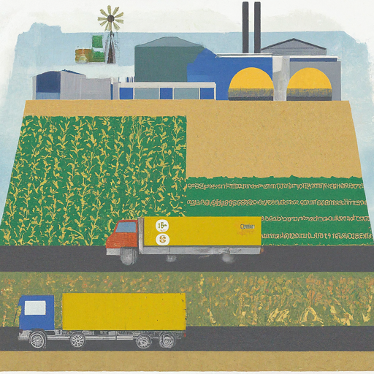
Optimizing Supply Chains with Quantum Computing
Quantum computing can improve the efficiency and sustainability of agricultural supply chains.
Simulations can model and optimize complex factors like weather, demand, and transportation.
This leads to reduced waste, lower costs, and increased profitability.
Real-time monitoring and optimization can respond to disruptions and changing conditions.
Quantum-enhanced logistics optimize routes, reducing delivery times and carbon emissions.

Slide 12
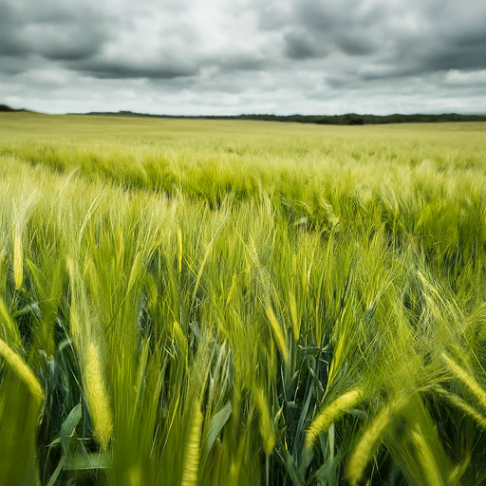
Case Studies: Quantum Computing in Agriculture
BASF and IBM are collaborating to develop more sustainable fertilizers using quantum computing.
Microsoft and Land O'Lakes are partnering to optimize agricultural supply chains using quantum-inspired algorithms.
ProteinQure is using quantum computing to design more effective and environmentally friendly pesticides.
QubitLife is leveraging quantum computing to develop drought-resistant crops.
Other companies are exploring quantum computing for soil analysis, disease detection, and livestock management.

Slide 13
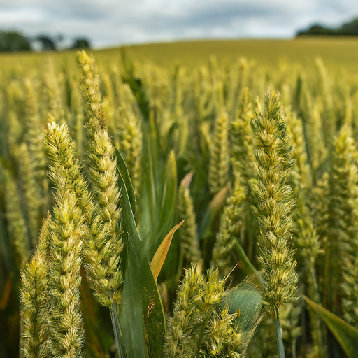
Challenges and Limitations
High cost of quantum hardware and maintenance.
Limited availability of skilled quantum computing experts.
Quantum computers are highly sensitive to environmental disturbances.
Ethical considerations surrounding data privacy and security.
Quantum computing is still in its early stages of development.

Slide 14
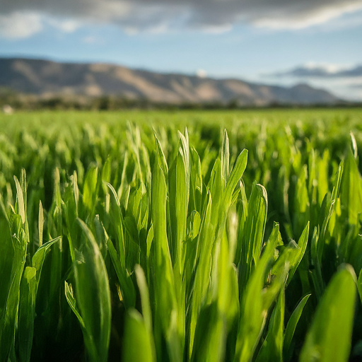
Quantum Computing: Shaping the Future of Agriculture
Quantum computing will revolutionize many aspects of agriculture, including crop breeding, pest control, and supply chain management.
Advancements in quantum algorithms and hardware will accelerate progress in quantum computing for agriculture.
Partnerships between quantum computing companies, agribusinesses, and research institutions will be crucial.
Governments and investors will play a key role in supporting the development and adoption of quantum computing in agriculture.

Slide 15

Ethical Considerations in Quantum Agriculture
Data privacy concerns: Who owns the agricultural data collected and how is it protected?
Algorithmic bias: Could quantum algorithms perpetuate existing inequalities or create new ones?
Impact on small-scale farmers: Will they be able to afford and access quantum technologies?
Environmental impact: Could unintended consequences arise from large-scale quantum computing use?
Responsible development: How can we ensure ethical considerations are integrated into quantum agricultural research?

Slide 16

Final Thoughts
Quantum computing offers transformative potential for the agriculture industry.
It can optimize crop yields, develop efficient fertilizers, and enhance pest control.
This technology addresses the global challenges of food security and sustainability.
Continued research, investment, and collaboration are essential to fully realize these benefits.
Quantum computing as the potential to transform agriculture and create a more sustainable future.

Slide 17
References
AZoQuantum. (2023). The Use of Quantum Technology in Agriculture.
Ray, S. (2022). Quantum computing for agriculture. Medium.
National Academies of Sciences, Engineering, and Medicine. (2019). Quantum computing: Progress and prospects. National Academies Press.
Huang, H., & Liu, N. (2022). Quantum algorithms for supply chain optimization. In International Conference on Service Systems and Service Management (pp. 359-368). Springer, Cham.

Slide 18
